Slide 1
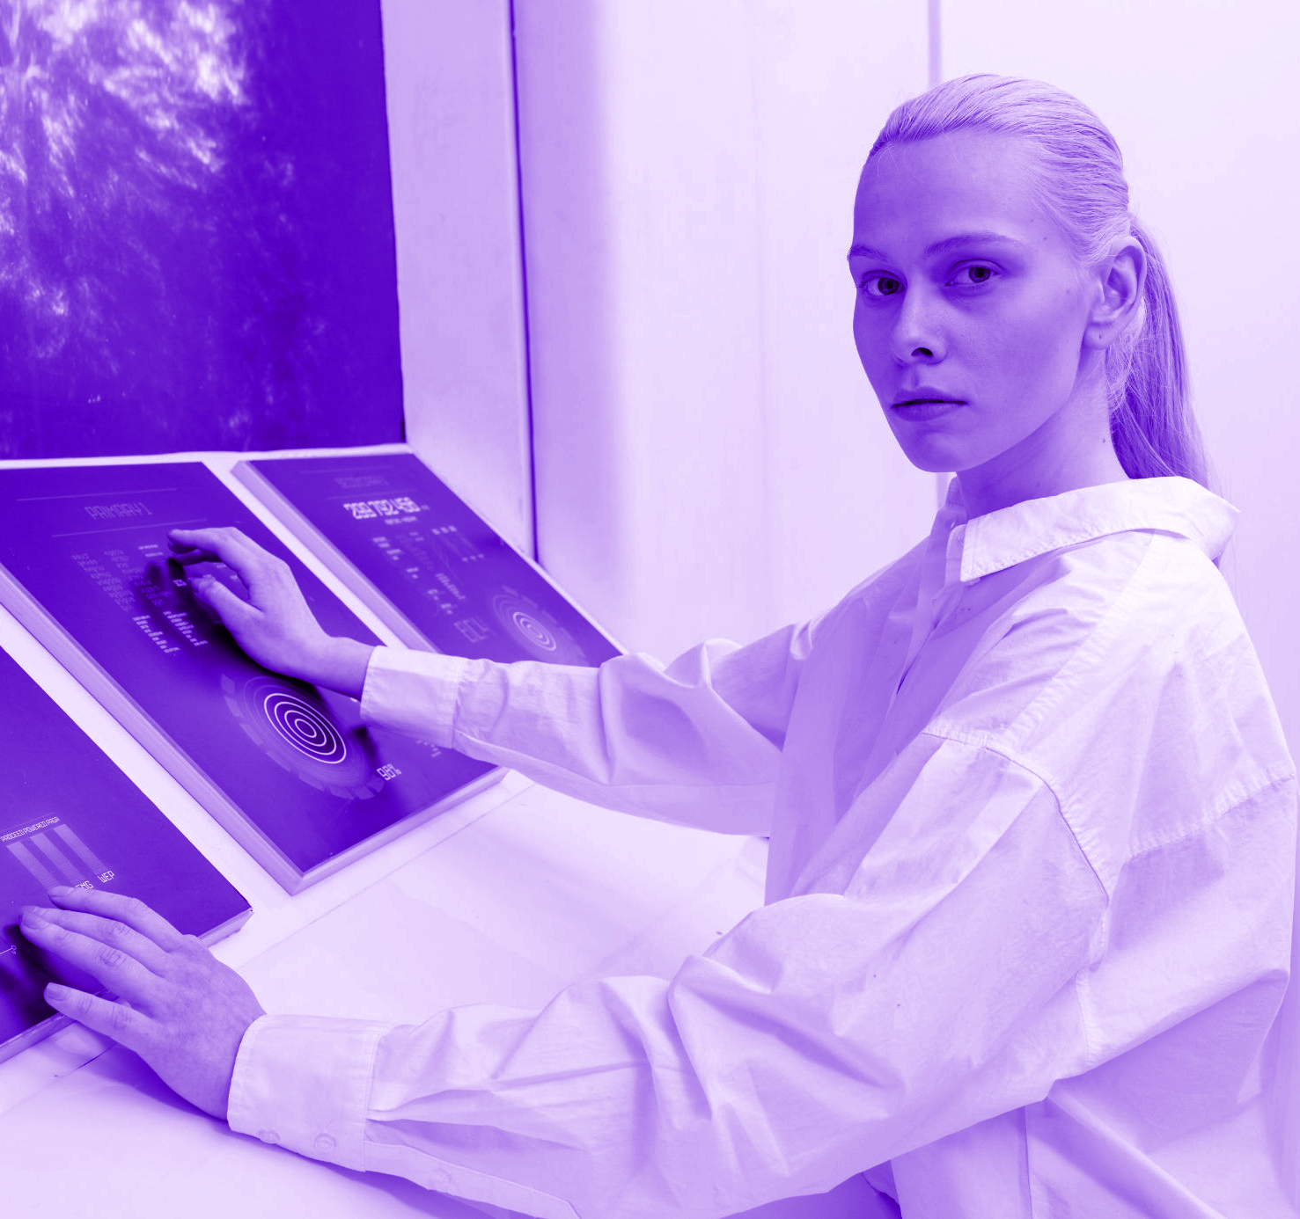
LINUX
The Differences
UNIX

Slide 2
// Nội Dung
01
02
Tiện ích_
Nguồn Gốc _
Hoạt động _
03
Quyền sở hữu_
06
Tính đặc thù _
04
Kỹ thuật_
05
Phần cứng_

Slide 3
// 1 - Nguồn gốc
Ken Thompson và Dennis Ritchie
Linus Torvalds
1970
1975
1990
1995
tại Bell Labs, , thuộc công ty AT&T nổi tiếng

Slide 4


// 2 – Tiện ích
UNIX
Cho các hệ thống máy chủ, máy trạm
Chỉ tương thích đối với các phần cứng nhất định

Slide 5



// 2 – Tiện ích
LINUX
Cho các hệ thống máy chủ,máy trạm và máy khách
Phân phối dễ dàng

Slide 6
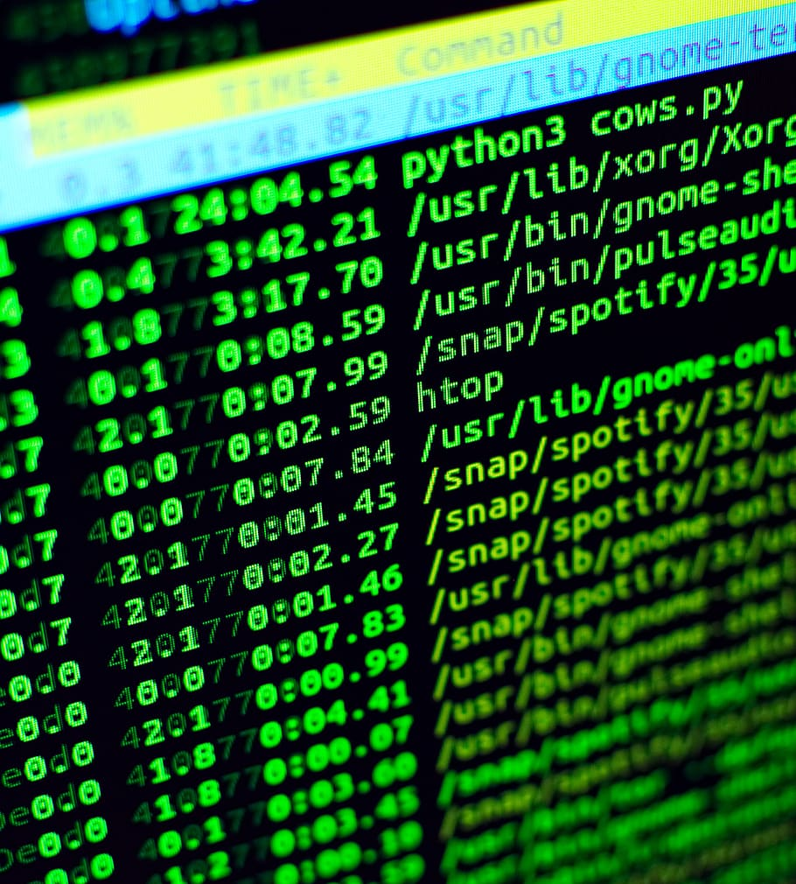
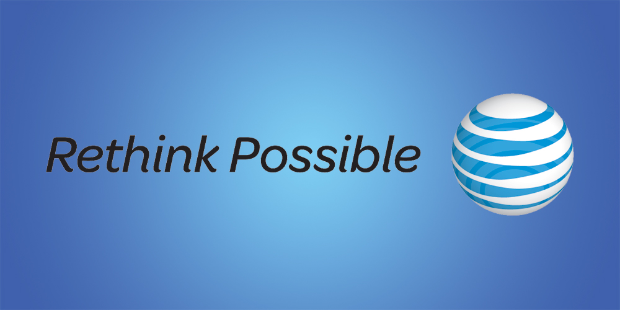
// 3 - Quyền sở hữu
UNIX
LINUX
một hệ thống độc quyền không thể sửa đổi
tài sản của công ty AT&T
giấy phép GNU
Miễn phí
Bất kỳ ai cũng có thể sửa đổi mã nguồn

Slide 7
// 4 – Kỹ Thuật
01
02
Đối tượng khách hàng
Nền tảng nhất định
UNIX
03
04
Mục Đích nhất định
Hệ điều hành thương mại

Slide 8
// 4 – Kỹ Thuật
Phát triển bời nhiều lập trình viên
Tổ hợp nhiều ý kiến,quan điểm, mục tiêu
Thời gian, bối cảnh khác nhau
LINUX

Slide 9
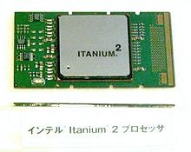
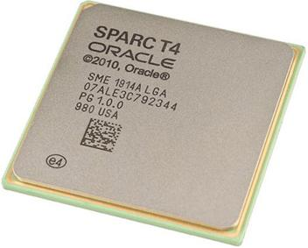
// 5 – Kiến trúc phần cứng
Lập trình để chạy trên một nhóm phần cứng nhất định
UNIX
Tối ưu trên một hệ thống phần cứng nhất định

Slide 10
// 5 – Kiến trúc phần cứng
Chạy trên các cấu trúc phần cứng
Khó khan trong việc tối ưu hệ điều hành
Linux
Các thiết bị ngoại , I/0 không giới hạn

Slide 11
// 6 – Tính đặc thù
// Hệ điều hành mở đóng là gì ?
UNIX
LINUX
Là 1 hệ điều hành đóng
Yêu cầu về tính bản quyền
Là 1 hệ điều hành mở
Không gặp trở ngại về yêu cầu về tính bản quyền
// Unix là mã nguồn đóng tại sao nhiều người vẫn có mã nguồn để phát triển riêng?

Slide 12
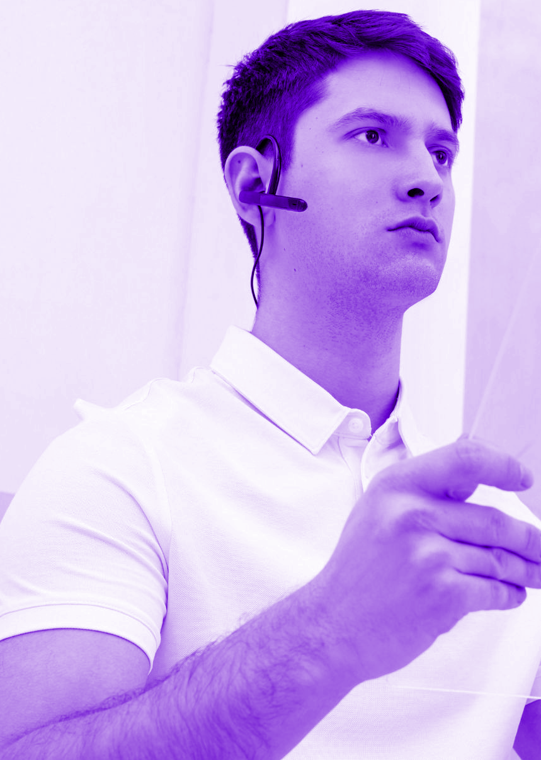
//THANKS
DO YOU HAVE ANY QUESTIONS?_
duypdhe160308@fpt.edu.vn.com
Phone numbers : 113
Please keep this slide for attribution

Slide 13
01
CENTER
// OUR
CENTER_
// OUR CENTER
/ You can enter a subtitle here if you need it

Slide 14
—WAYNE GRETZKY
// TECHNOLOGY
“You lose 100% of the attempts you never tried”
// INNOVATION

Slide 15
// KEY NUMBERS
20,000
50,000
5,000
This is the number of
patients we had last month
This is the number of total visitors we had last month
This is the number of
transplants performed so far

Slide 16
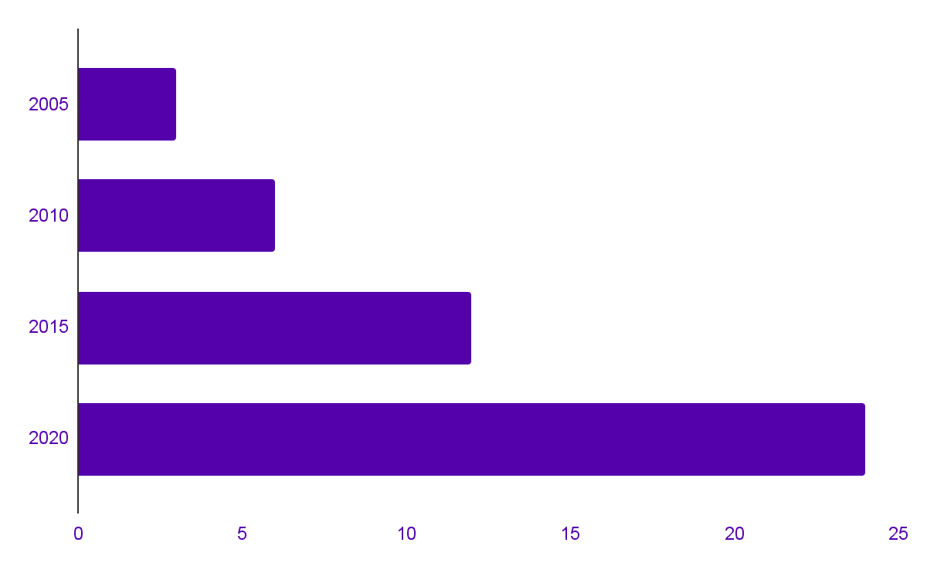
//OUR PROGRESS BY YEAR
SERVICES
WE OFFER
Mercury is the closest planet to the Sun and
the smallest one in the Solar System
Follow the link in the graph to modify its data and then paste the new one here. For more info, click here

Slide 17
//HAPPY
// TECHNOLOGY
TO HELP
_
// INNOVATION

Slide 18
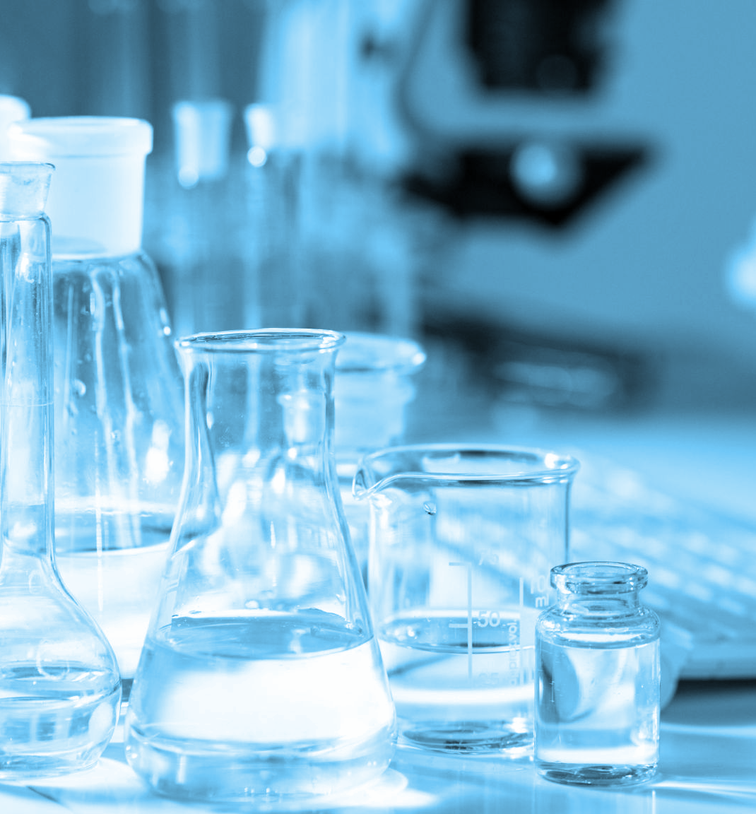
//A BRIEF
// A BRIEF STORY
STORY
Mercury is the closest planet to the Sun and the smallest one in the Solar System—it’s only a bit larger than the Moon. The planet’s name has nothing to do with the liquid metal, since it was named after the Roman messenger god, Mercury

Slide 19
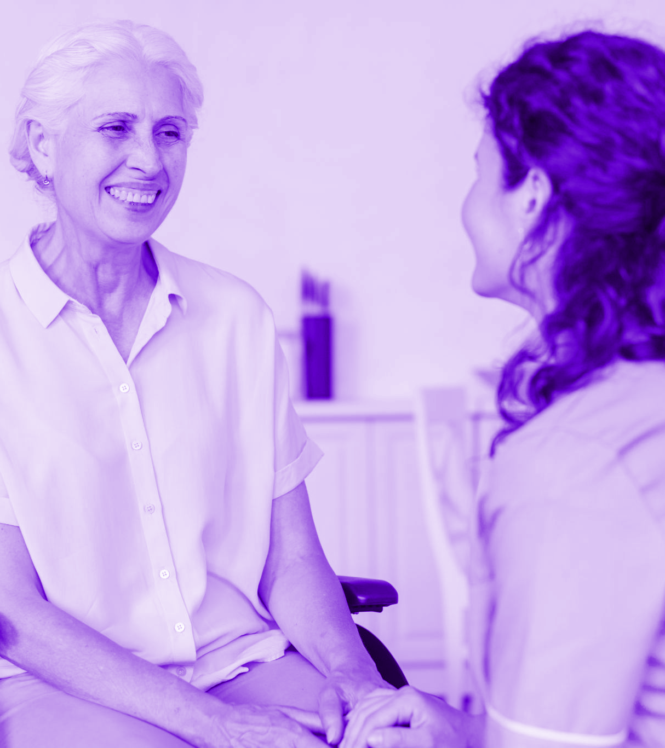
// PATIENT CARE
// PATIENT CARE
Mercury is the closest planet to the Sun and the smallest one in the Solar System—it’s only a bit larger than the Moon. The planet’s name has nothing to do with the liquid metal, since it was named after the Roman messenger god

Slide 20
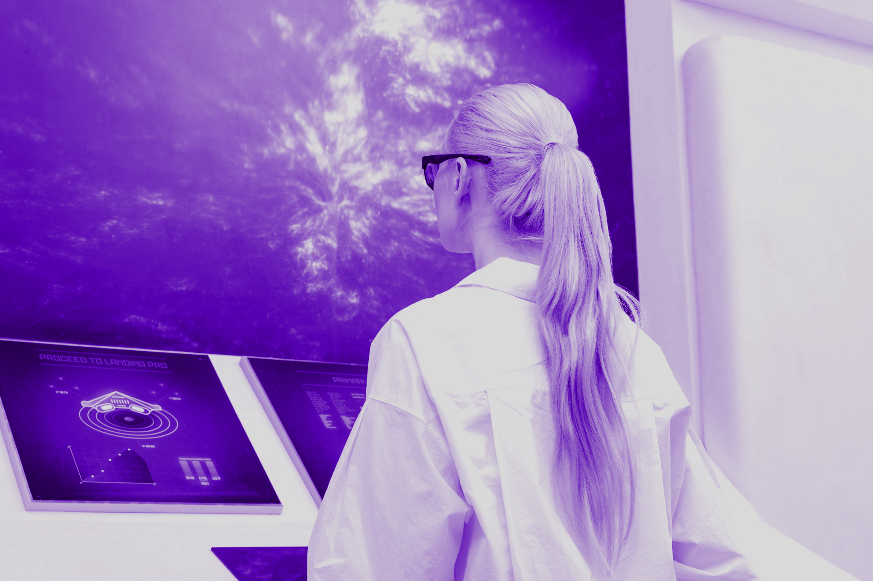
04
CENTER
// KEY
ACCOMPLISHMENTS _
// OUR ACCOMPLISHMENT
/ You can enter a subtitle here if you need it

Slide 21
// INNOVATIONS
// KEY ACCOMPLISHMENTS
MERCURY
VENUS
MARS
Mercury is the closest planet to
the Sun
Venus has a beautiful name, but it’s terribly hot
Despite being red, Mars is a very
cold place

Slide 22
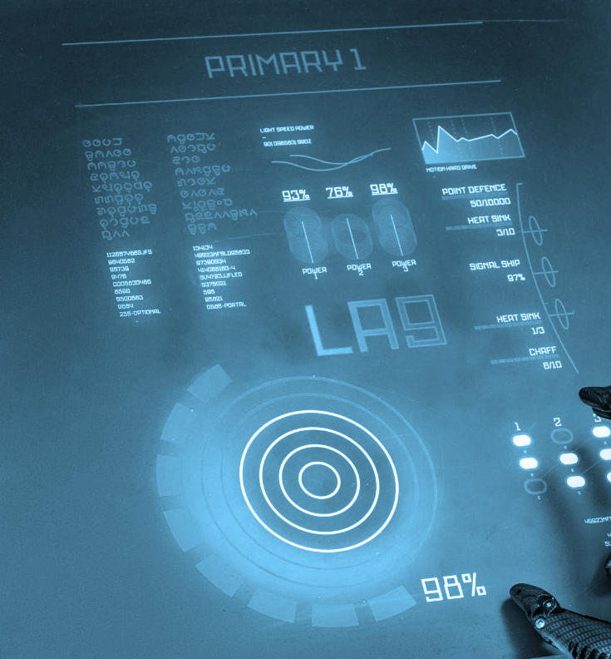
// PATIENT
98%
SATISFACTION
Mercury is the closest planet to the Sun and the smallest one in the Solar System—it’s only a bit larger than the Moon

Slide 23
// INNOVATIONS
MERCURY
VENUS
MARS
Mercury is the closest planet to the Sun
Venus is the second planet from the Sun
Despite being red, Mars is a cold place

Slide 24
// QUALITY IMPROVEMENT
MERCURY
VENUS
MARS
SATURN
JUPITER
NEPTUNE
MEASURES
Mercury is the closest
planet to the Sun
Venus is the second planet from the Sun
Despite being red, Mars Is a cold place
Yes, this is the ringed one. It’s a gas giant
It’s the biggest planet
in the Solar System
It’s the farthest planet from the Sun

Slide 25
TESTIMONIALS
JENNA DOE
JOHN JAMES
FRED BLOGGS
HELENA PATTERSON
25
36
“Neptune is the fourth-largest planet by diameter in the Solar System”
“Mercury is the closest to the Sun and the smallest in the Solar System”
31
58
“Despite being red, Mars is a cold. The planet is full of iron oxide dust”
“Saturn is the ringed one. It’s a gas giant, composed of hydrogen and helium”

Slide 26
//AWARDS
Saturn is a gas giant and has several rings
Mercury is the closest planet to the Sun
2010
2020
2005
2015
Jupiter is the
biggest planet of them all
Despite being red, Mars is a cold place

Slide 27
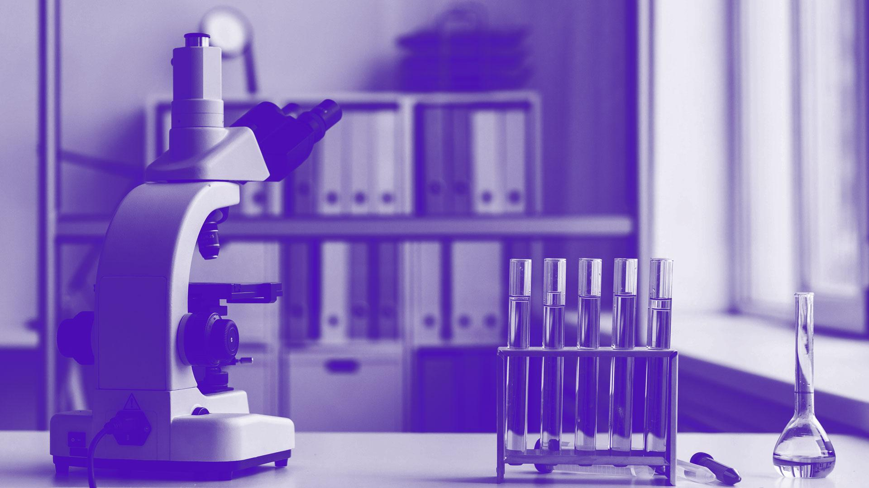
// TECHNOLOGY
//A PICTURE IS
WORTH A
THOUSAND WORDS
// INNOVATION

Slide 28
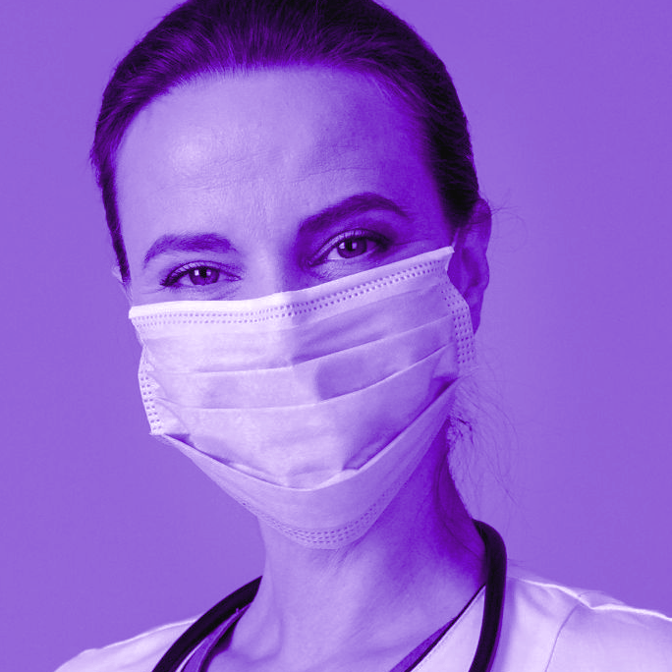
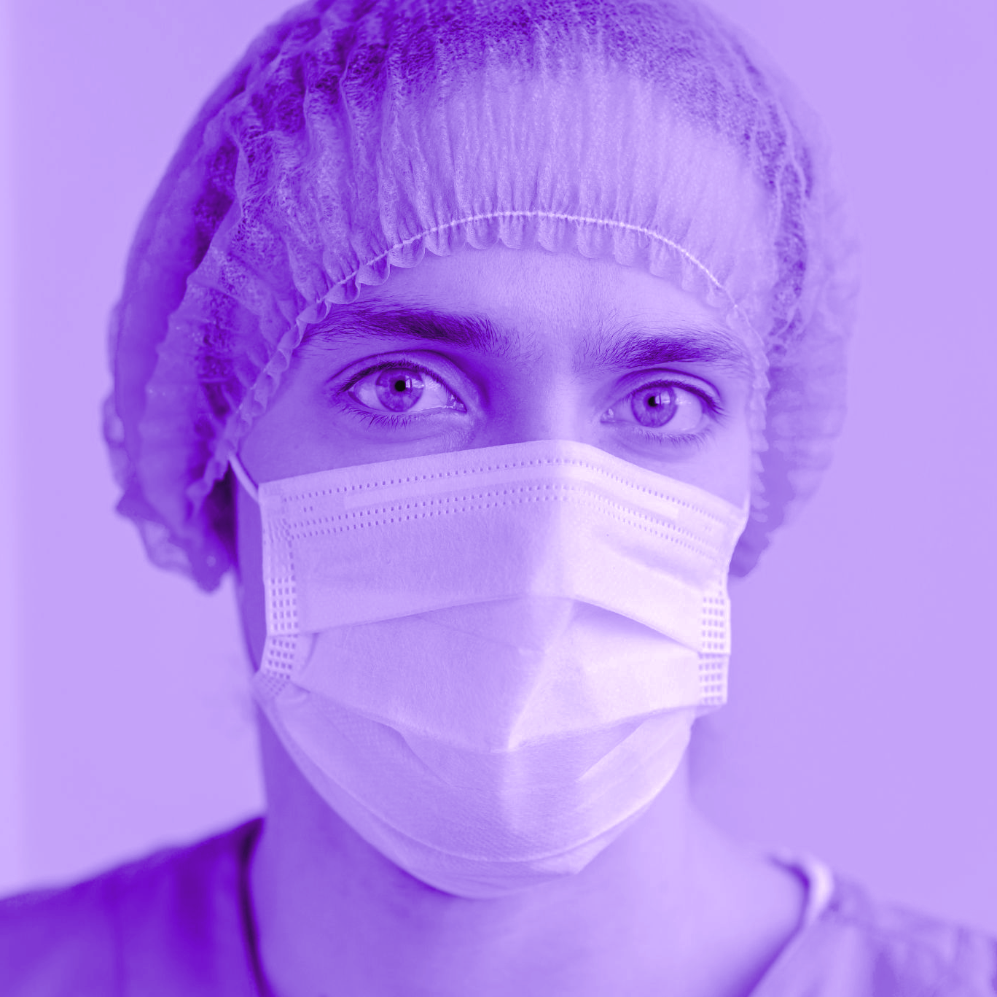
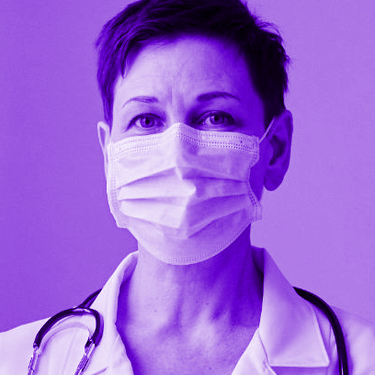
// OUR TEAM
// OUR TEAM
NURSE
DOCTOR
SURGEON
You can talk a bit about this person
You can talk a bit about this person
You can talk a bit about this person

Slide 29
// COVERAGE IN THE WORLD
EARTH
1,200,000+
Earth is the third planet from the Sun and the only one that harbors life in the Solar System. This is where we all live on

Slide 30
// TREATMENTS WE COVER
Surgery | Knee | Colon | Cardiovascular | Gynecology | Shoulder
Treatment | Stroke | Brain tumor | Blood clot | Brain aneurysm | Arrhythmia
Procedures | Adrenal gland | Aortic valve | Pediatric gastric | Pediatric Orthopaedic | Prostate Procedures
Diagnostic | Gastric | Urologic | Gynecologic | Orthopaedic | Hip

Slide 31
// WEBSITE
You can replace the image on the screen with your own work. Just right-click on it and select “Replace image”

Slide 32
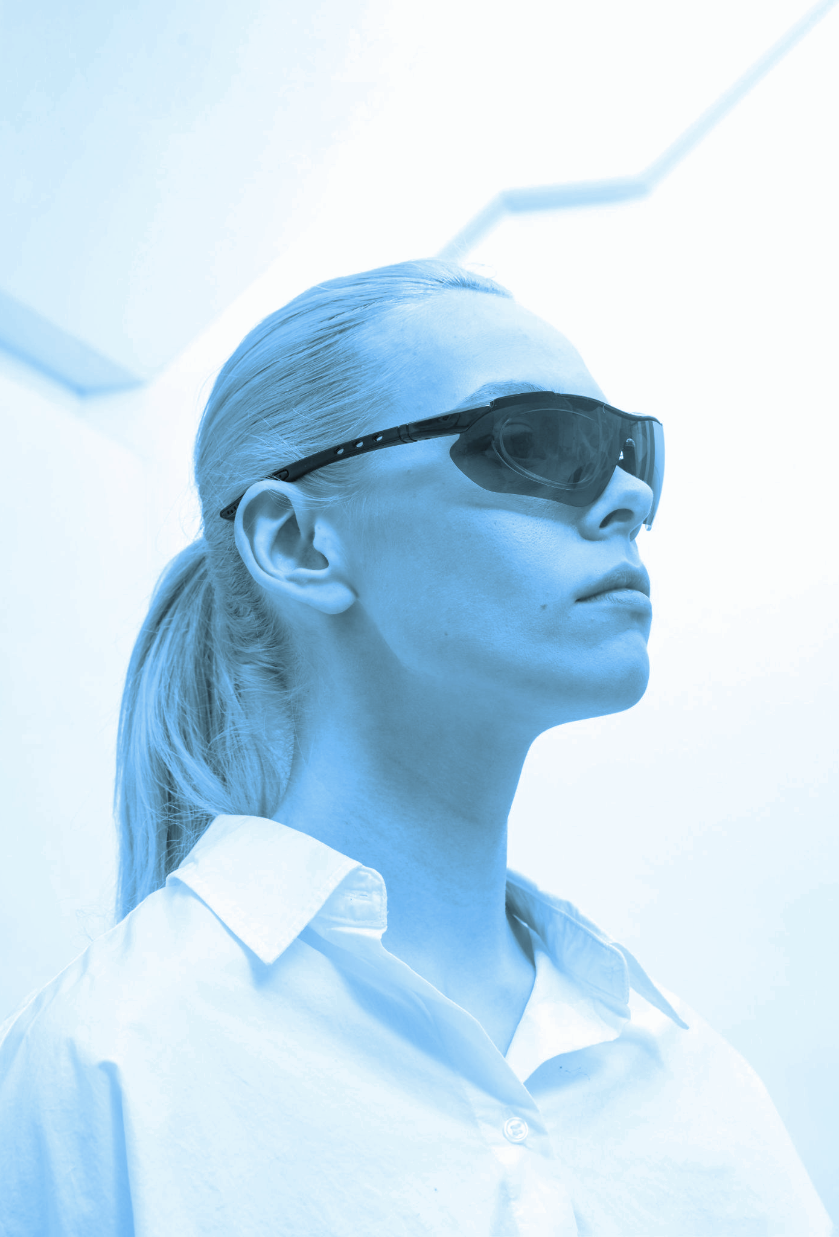
// PHOTO EFFECTS
// TRY THIS EFFECT
If you want to apply the same filter as the pictures already included in the template, follow these instructions:
In Google Slides:
Insert the picture into the slide
Go to Format options > Recolor. Choose Light 1 (purple pictures) or Dark 2 (Blue pictures) and then apply a bit of transparency if necessary

Slide 33
ALTERNATIVE RESOURCES
Here’s an assortment of alternative resources whose style fits that of this template
PHOTOS
Young woman with digital glasses
Young man wearing white clothes using tablet
Woman wearing digital glasses
Close up man wearing protection equipment
Close-up hands holding pipette
Close-up researcher holding glassware
Close-up man working with microscope

Slide 34
RESOURCES
Did you like the resources on this template? Get them for free at our other websites:
PHOTOS
Side view woman working Digital monitors
Young woman wearing white clothes
Close up woman working on digital monitors
Close up researcher looking through ocular lens
Close-up blurry researcher holding glassware
Nurse looking at female senior patient on wheelchair
Side view woman with digital glasses working on monitor
Close up woman working digital monitors
Arrangement with microscope and tubes
Female doctor at hospital wearing mask
Portrait male nurse with mask
Front view of elder covid recovery center female doctor with medical mask
Young man with bluetooth headphone
Woman wearing digital glasses
VECTORS
Flat medical infographic

